Slide 1

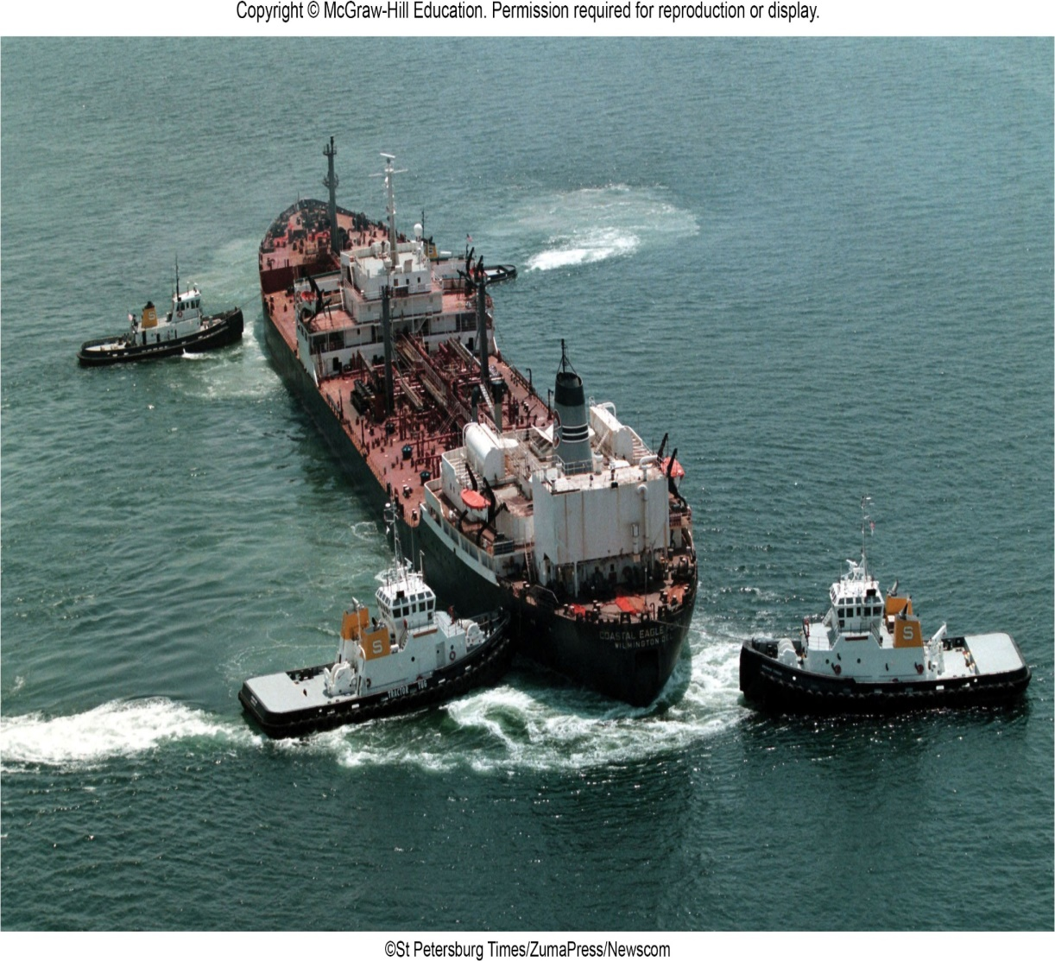
VECTOR MECHANICS FOR ENGINEERS
By: Fardinand P. Beer; E. Russell Johnston, Jr.; David F. Mazurek
ENGINEERING 3120
STATICS
CHAPTER 3
RIGID BODIES
EQUIVALENT SYSTEM OF FORCES
Slides revised by:
A.A. KHANDKER, Ph.D., P.E.
Copyright: McGraw Hill Education

Slide 2
RIGID BODIES - TOPICS IN CHAPTER 3
Introduction
External and Internal Forces
Principle of Transmissibility: Equivalent Forces
Vector Products of Two Vectors
Moment of a Force About a Point
Varigon’s Theorem
Rectangular Components of the Moment of a Force
Sample Problem 3.1
Scalar Product of Two Vectors
Scalar Product of Two Vectors: Applications
Mixed Triple Product of Three Vectors
Moment of a Force About a Given Axis
Sample Problem 3.5
Moment of a Couple
Addition of Couples
Couples Represented By Vectors
Resolution of a Force Into a Force at O and a Couple
Sample Problem 3.6
System of Forces: Reduction to a Force – Couple System
Further Reduction of a System of Forces
Sample Problem 3.8
Sample Problem 3.10

Slide 3
RIGID BODIES - INTRODUCTION
Treatment of a body as a single particle is not always possible. In general, the size of the body and the specific points of application of the forces must be considered.
Most bodies in elementary mechanics are assumed to be rigid, i.e., the actual deformations are small and do not affect the conditions of equilibrium or motion of the body.
Current chapter describes the effect of forces exerted on a rigid body and how to replace a given system of forces with a simpler equivalent system.
Moment of a force about a point
Moment of a force about an axis
Moment due to a couple
Any system of forces acting on a rigid body can be replaced by an equivalent system consisting of one force acting at a given point and one couple.

Slide 4
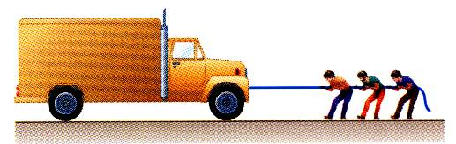
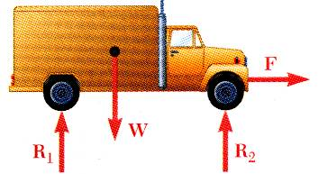
EXTERNAL AND INTERNAL FORCES
Forces acting on rigid bodies are divided into two groups:
External forces
Internal forces
External forces are shown in a free-body diagram.
If unopposed, each external force can impart a motion of translation or rotation, or both.
Internal forces, such as the force between each wheel and the axel it is mount on, are not shown on a free body diagram.

Slide 5
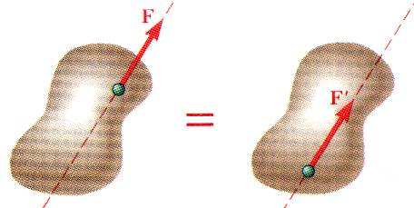
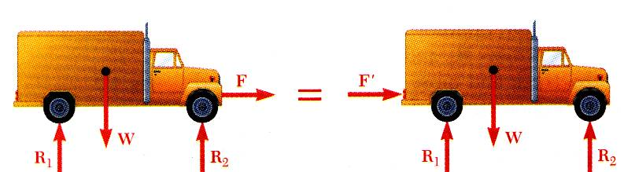
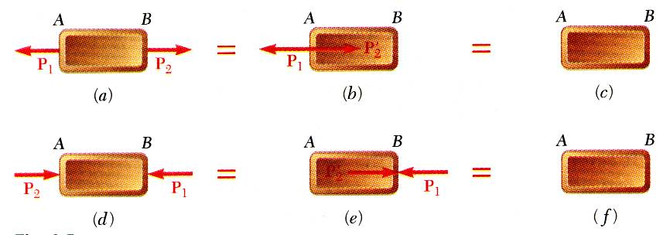
PRINCIPLE OF TRANSMISSIBILITY – EQUIVALENT FORCE
Principle of Transmissibility - Conditions of equilibrium or motion are not affected by transmitting a force along its line of action. NOTE: F and F’ are equivalent forces.
Moving the point of application of the force F to the rear bumper does not affect the motion or the other forces acting on the truck.
Principle of transmissibility may not always apply in determining internal forces and deformations.

Slide 6
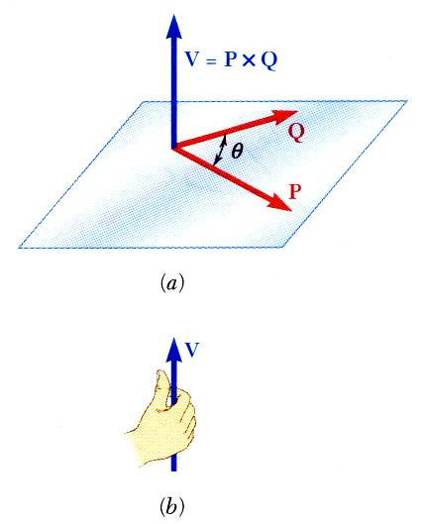
VECTOR PRODUCTS – TWO VECTORS
Concept of the moment of a force about a point is more easily understood through applications of the vector product or cross product.
Vector product of two vectors P and Q is defined as the vector V which satisfies the following conditions:
Line of action of V is perpendicular to plane containing P and Q.
Magnitude of V is
Direction of V is obtained from the right-hand rule.
Vector products:
are not commutative,
are distributive,
are not associative,

Slide 7
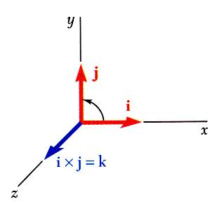
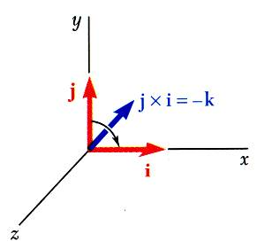
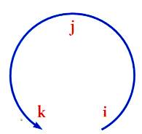
VECTOR PRODUCTS – RECTANGULAR COORDINATES
Vector products of Cartesian unit vectors,
Vector products in terms of rectangular coordinates

Slide 8
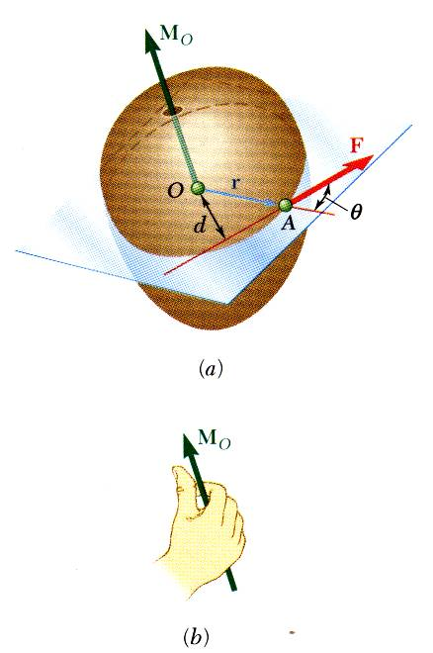
MOMENT OF A FORCE ABOUT A POINT
A force vector is defined by its magnitude and direction. Its effect on the rigid body also depends on it point of application.
The moment of F about O is defined as
The moment vector M_{O} is perpendicular to the plane containing O and the force F.
Magnitude of M_{O} measures the tendency of the force to cause rotation of the body about an axis along M_{O}. The sense of the moment may be determined by the right-hand rule.
Any force F’ that has the same magnitude and direction as F, is equivalent if it also has the same line of action and therefore, produces the same moment.

Slide 9
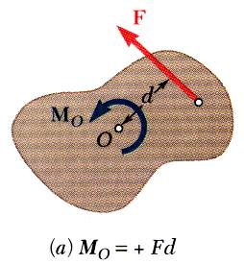
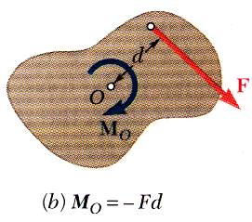
MOMENT OF A FORCE ABOUT A POINT
Two-dimensional structures have length and breadth but negligible depth and are subjected to forces contained in the plane of the structure.
The plane of the structure contains the point O and the force F. M_{O}, the moment of the force about O is perpendicular to the plane.
a) If the force tends to rotate the structure counter-clockwise, the sense of the moment vector is out of the plane of the structure and the magnitude of the moment is positive.
If the force tends to rotate the structure clockwise, the sense of the moment vector is into the plane of the structure and the magnitude of the moment is negative.

Slide 10
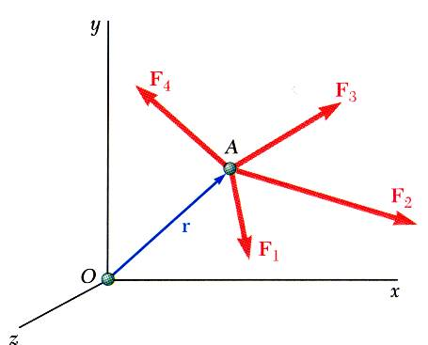
MOMEMTS ABOUT A POINT - VARIGNON’S THEOREM
Varignon’s Theorem
The moment about a given point O of the resultant of several concurrent forces is equal to the sum of the moments of the various forces about the same point O.
Varignon’s Theorem makes it possible to replace the direct determination of the moment of a force F by the moments of two or more component forces of F.

Slide 11
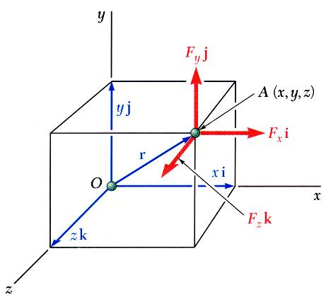

RECTANGULAR CONPONENTS OF THE MOMENTS OF A FORCE
The moment of F about O,
$${\vec{M}}_{o}$$
The components of - M_{x}, M_{y}, and M_{z}, represent the moments about the x, y and z-axis, respectively.

Slide 12
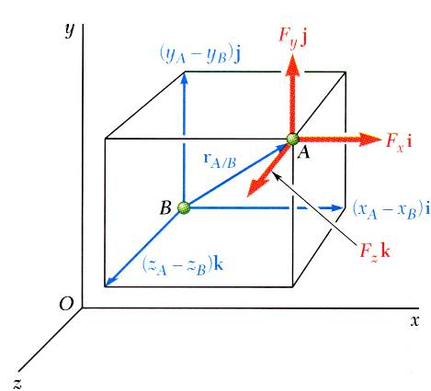
RECTANGULAR CONPONENTS OF THE MOMENTS OF A FORCE
The moment of F about B,

Slide 13
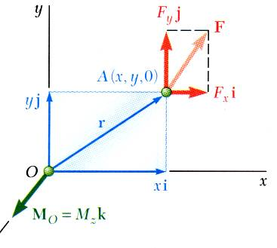
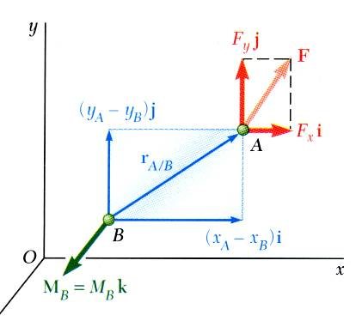
RECTANGULAR CONPONENTS OF THE MOMENTS OF A FORCE
For two-dimensional structures,

Slide 14
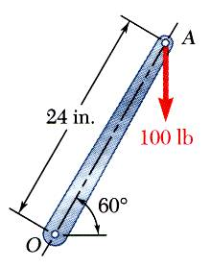
EXAMPLE PROBLEM 3.1
A 100-lb vertical force is applied to the end of a lever which is attached to a shaft at O.
Determine:
moment about O,
horizontal force at A which creates the same moment,
smallest force at A which produces the same moment,
location for a 240-lb vertical force to produce the same moment,
whether any of the forces from b, c, and d is equivalent to the original force.

Slide 15
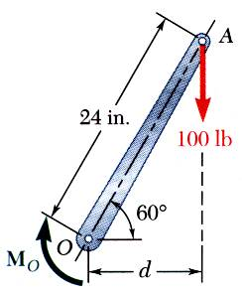
EXAMPLE PROBLEM 3.1 - SOLUTION
STRATEGY: The calculations asked for all involve variations on the basic defining equation of a moment, M_{O} = Fd.
MODELING and ANALYSIS
a) Moment about O is equal to the product of the force and the perpendicular distance between the line of action of the force and O. Since the force tends to rotate the lever clockwise, the moment vector is into the plane of the paper.

Slide 16
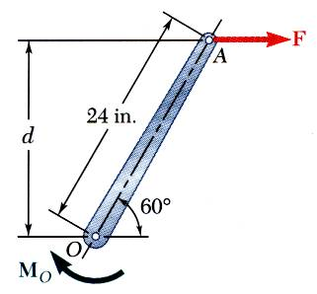
EXAMPLE PROBLEM 3.1 – SOLUTION (continued)
b) Horizontal force at A that produces the same moment,
Why must the direction of this F be to the right?

Slide 17
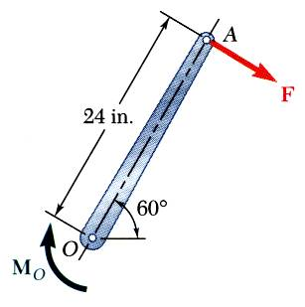
EXAMPLE PROBLEM 3.1 – SOLUTION (continued)
F(min) ?
What is the smallest force at A which produces the same moment? Think about it and discuss with a class mate.
c) The smallest force A to produce the same moment occurs when the perpendicular distance is a maximum or when F is perpendicular to OA.

Slide 18
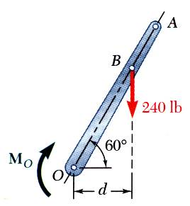
EXAMPLE PROBLEM 3.1 – SOLUTION (continued)
d) To determine the point of application of a 240 lb force to produce the same moment,

Slide 19
EXAMPLE PROBLEM 3.1 – SOLUTION (continued)
e) Although each of the forces in parts b), c), and d) produces the same moment as the 100 lb force, none are of the same magnitude and sense, or on the same line of action. None of the forces is equivalent to the 100 lb force.
REFLECT and THINK: Various combinations of force and lever arm can produce equivalent moments, but the system of force and moment produces a different overall effect in each case.

Slide 20
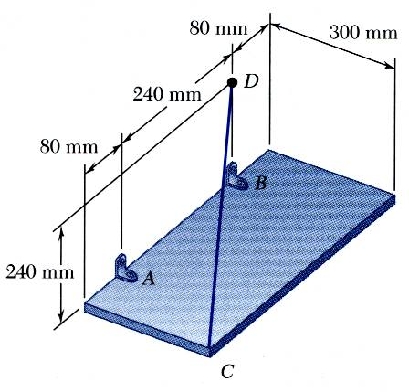
EXAMPLE PROBLEM 3.4
The rectangular plate is supported by the brackets at A and B and by a wire CD. Knowing that the tension in the wire is 200 N, determine the moment about A of the force exerted by the wire at C.
SOLUTION:
The moment M_{A} of the force F exerted by the wire is obtained by evaluating the vector product,

Slide 21
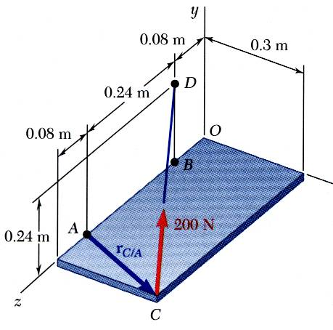
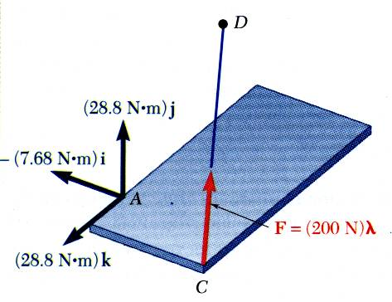
EXAMPLE PROBLEM 3.4 - SOLUTION

Slide 22
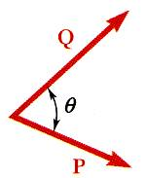
SCALAR PRODUCT OF TWO VECTORS
The scalar product or dot product between two vectors P and Q is defined as
Scalar products:
are commutative,
are distributive,
are not associative,
Scalar products with Cartesian unit components,

Slide 23
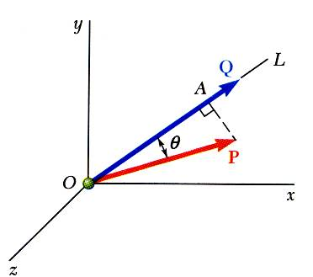
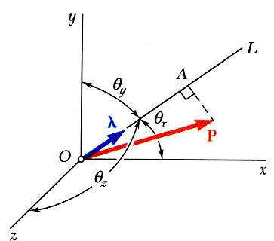
SCALAR PRODUCT OF TWO VECTORS - APPLICATIONS
Angle between two vectors:
Projection of a vector on a given axis:
For an axis defined by a unit vector:

Slide 24
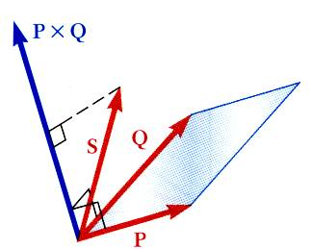
MIXED TRIPLE PRODUCT OF THREE VECTORS
Mixed triple product of three vectors,
The six mixed triple products formed from S, P, and Q have equal magnitudes but not the same sign,
Evaluating the mixed triple product,

Slide 25
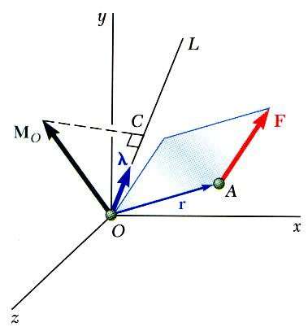
MOMENT OF A FORCE ABOUT A GIVEN AXIS
Moment M_{O} of a force F applied at the point A about a point O,
Scalar moment M_{OL} about an axis OL is the projection of the moment vector M_{O} onto the axis,
Moments of F about the coordinate axes,

Slide 26
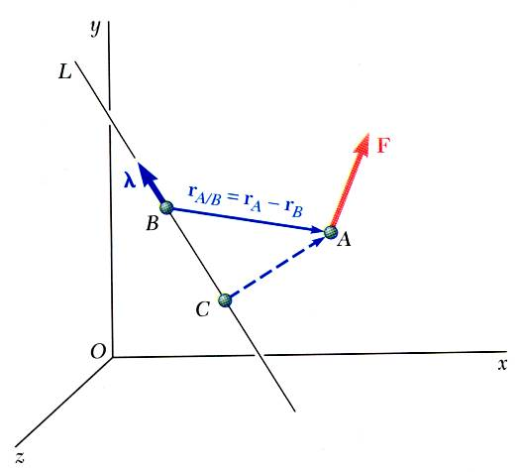
MOMENT OF A FORCE ABOUT A GIVEN AXIS
Moment of a force about an arbitrary axis,
The result is independent of the point B along the given axis.

Slide 27
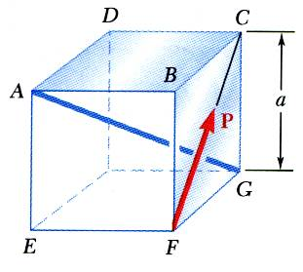
EXAMPLE PROBLEM 3.5
A cube is acted on by a force P as shown.
Determine the moment of P
about A
about the edge AB and
about the diagonal AG of the cube.
Determine the perpendicular distance between AG and FC.

Slide 28
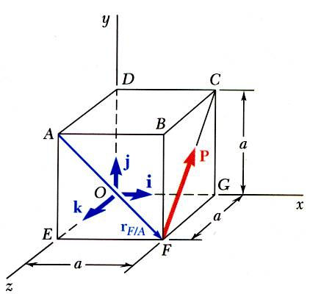
EXAMPLE PROBLEM 3.5 - SOLUTION
a) Moment of P about A,
b) Moment of P about AB,

Slide 29
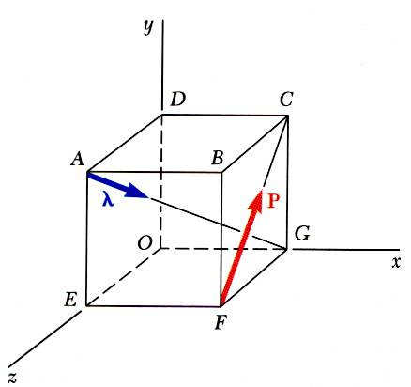
EXAMPLE PROBLEM 3.5 - SOLUTION
c) Moment of P about the diagonal AG,

Slide 30
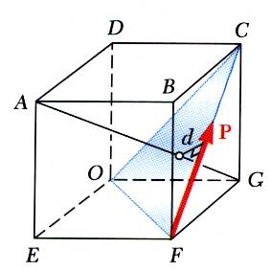
EXAMPLE PROBLEM 3.5 - SOLUTION
d) Perpendicular distance between AG and FC,
Therefore, P is perpendicular to AG.

Slide 31
EXAMPLE PROBLEM 3.5 - SOLUTION
d) Perpendicular distance between AG and FC,
Therefore, P is perpendicular to AG.

Slide 32
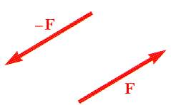
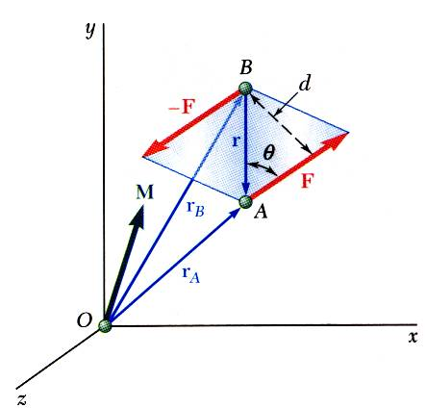
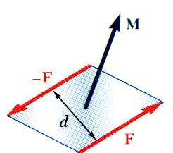
DEFINITION OF A COUPLE – MOMENT OF A COUPLE
Two forces F and -F having the same magnitude, parallel lines of action, and opposite sense are said to form a couple.
Moment of the couple,
The moment vector of the couple is independent of the choice of the origin of the coordinate axes, i.e., it is a free vector that can be applied at any point with the same effect.

Slide 33
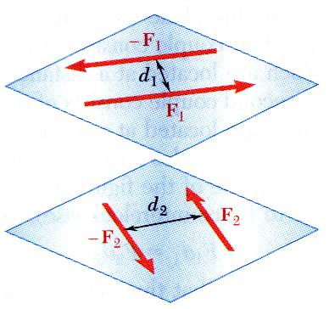
MOMENT OF A COUPLE – EQUAL MOMENTS
Two couples will have equal moments if
the two couples lie in parallel planes,
and
the two couples have the same sense or the tendency to cause rotation in the same direction.

Slide 34
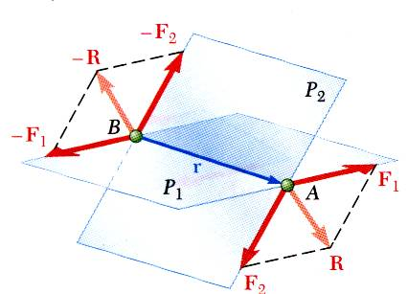
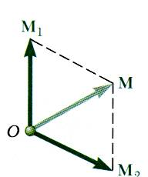
ADDITION OF COUPLES
Consider two intersecting planes P₁ and P₂ with each containing a couple
Resultants of the vectors also form a couple
Using Varigon’s theorem
Sum of two couples is also a couple that is equal to the vector sum of the two couples

Slide 35
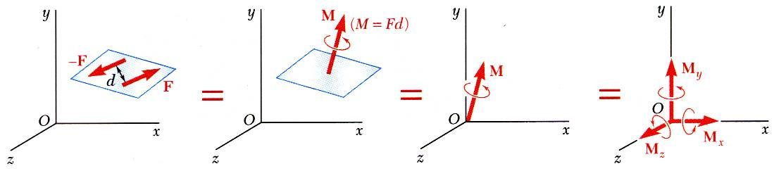
COUPLES CAN BE REPRESENTED BY VECTORS
A couple can be represented by a vector with magnitude and direction equal to the moment of the couple.
Couple vectors obey the law of addition of vectors.
Couple vectors are free vectors, i.e., the point of application is not significant.
Couple vectors may be resolved into component vectors.

Slide 36
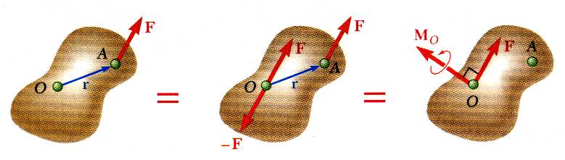
RESOLUTION OF A FORCE INTO A FORCE AT O AND A COUPLE
Force vector F can not be simply moved to O without modifying its action on the body.
Attaching equal and opposite force vectors at O produces no net effect on the body.
The three forces may be replaced by an equivalent force vector and couple vector, i.e, a force-couple system.

Slide 37
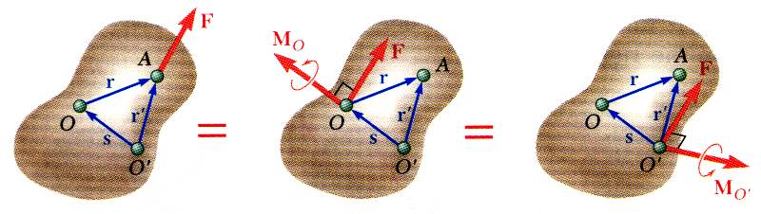
RESOLUTION OF A FORCE INTO A FORCE AT O AND A COUPLE
Moving F from A to a different point O’ requires the addition of a different couple vector M_{O’}
The moments of F about O and O’ are related,
Moving the force-couple system from O to O’ requires the addition of the moment of the force at O about O’.

Slide 38
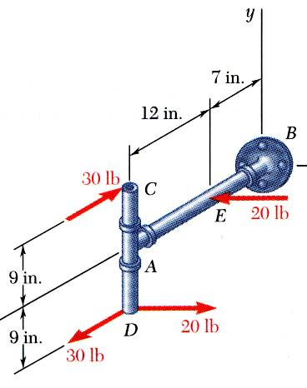
EXAMPLE PROBLEM 3.6
SOLUTION:
Attach equal and opposite 20 lb forces in the +x direction at A, thereby producing 3 couples for which the moment components are easily computed.
Alternatively, compute the sum of the moments of the four forces about an arbitrary single point. The point D is a good choice as only two of the forces will produce non-zero moment contributions.
Determine the components of the single couple equivalent to the couples shown.

Slide 39
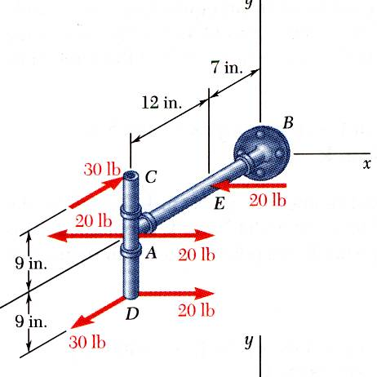
EXAMPLE PROBLEM 3.6 - SOLUTION
Attach equal and opposite 20 lb forces in the +x direction at A
The three couples may be represented by three couple vectors,

Slide 40
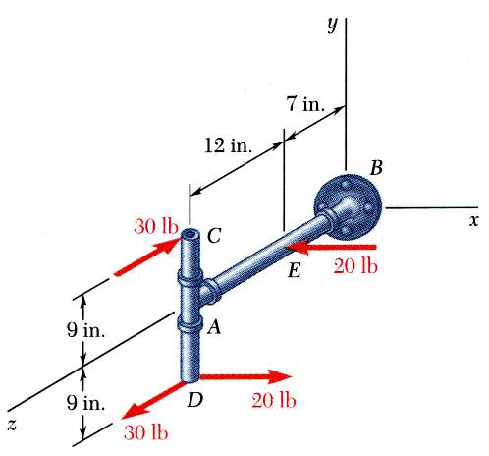
EXAMPLE PROBLEM 3.6 – ALTERNATIVE SOLUTION
Alternatively, compute the sum of the moments of the four forces about D.
Only the forces at C and E contribute to the moment about D.

Slide 41
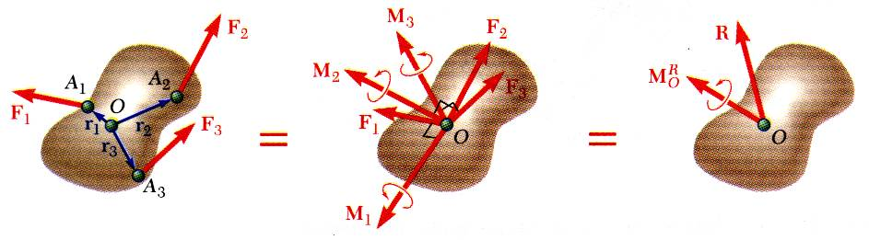

SYSTEM OF FORCES - REDUCTION TO A FORCE AND COUPLE
Two systems of forces are equivalent if they can be reduced to the same system of force-couple.
A system of forces may be replaced by a collection of force-couple systems acting a given point O
The force and couple vectors may be combined into a resultant force vector and a resultant couple vector,
The force-couple system at O may be moved to O’ with the addition of the moment of R about O’ ,

Slide 42



FURTHER REDUCTION OF A SYSTEM OF FORCES
If the resultant force and couple at O are mutually perpendicular, they can be replaced by a single force acting along a new line of action.
The resultant force-couple system for a system of forces will be mutually perpendicular if: 1) the forces are concurrent, 2) the forces are coplanar, or 3) the forces are parallel.
Concurrent Forces
Coplanar Forces
Parallel Forces

Slide 43





FURTHER REDUCTION OF A SYSTEM OF FORCES
COPLANAR FORCES
System of coplanar forces is reduced to a force-couple system that is mutually perpendicular.
System can be reduced to a single force by moving the line of action of until its moment about O becomes
In terms of rectangular coordinates,

Slide 44

EXAMPLE PROBLEM 3.8
SOLUTION STEPS:
Compute the resultant force for the forces shown and the resultant couple for the moments of the forces about A.
Find an equivalent force-couple system at B based on the force-couple system at A.
Determine the point of application for the resultant force such that its moment about A is equal to the resultant couple at A.
For the beam shown above, reduce the system of forces to
an equivalent force-couple system at A,
(b) an equivalent force couple system at B, and
(c) a single force or resultant.
Note: Since the support reactions are not included, the given system will not maintain the beam in equilibrium.

Slide 45


EXAMPLE PROBLEM 3.8 - SOLUTION
Compute the resultant force and the resultant couple at A.

Slide 46


EXAMPLE PROBLEM 3.8 – SOLUTION (Continued)
Find an equivalent force-couple system at B based on the force-couple system at A.
The force is unchanged by the movement of the force-couple system from A to B.
The couple at B is equal to the moment about B of the force-couple system found at A.

Slide 47

EXAMPLE PROBLEM 3.8 – SOLUTION (Continued)
c) Determine the point of application for the resultant force such that its moment about A is equal to the resultant couple at A.
The resultant of the given system of forces is equal to R, and its point of application must be such that the moment of R about A is equal to . This equality of moments leads to
Solving for x, you get x = 3.13 m. Thus, the single force equivalent to the given system is defined as
REFLECT and THINK:
This reduction of a given system of forces to a single equivalent force uses the same principles that you will use later for finding centers of gravity and centers of mass, which are important parameters in engineering mechanics.

Slide 48

EXAMPLE PROBLEM 3.10
STRATEGY:
Determine the relative position vectors for the points of application of the cable forces with respect to A.
Resolve the forces into rectangular components.
Compute the equivalent force,
Three cables are attached to the bracket as shown. Replace the forces with an equivalent force-couple system at A.
Compute the equivalent couple,

Slide 49
EXAMPLE PROBLEM 3.10 – SOLUTION
Resolve the forces into rectangular components.
Determine the relative position vectors with respect to A.

Slide 50

EXAMPLE PROBLEM 3.10 – SOLUTION (continued)
Compute the equivalent force,

Slide 51
EXAMPLE PROBLEM 3.10 – SOLUTION (continued)
Compute the equivalent couple,
REFLECT and THINK:
The determinant approach to calculating moments shows its advantages in a general three-dimensional problem such as this.

